Slide 4
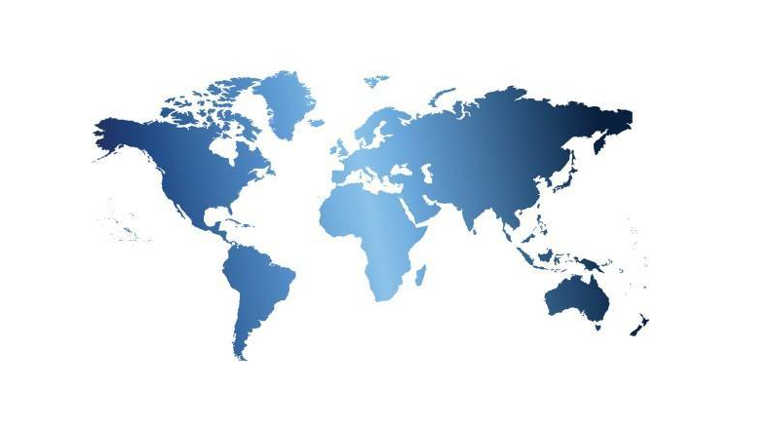

Slide 5
I’m Ready!

Slide 6
You have one minute to choose the BEST Havoc Pack to survive a Thunderstorm & Lightning!

Slide 7
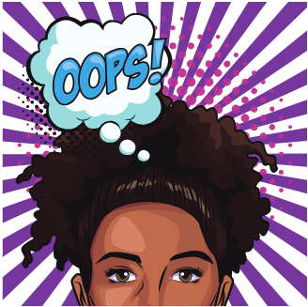
You ran out of time . . . try again.
Try Again

Slide 8
Good job! You picked the correct Havoc Pack!
The BEST things to do when a thunderstorm & lightning strike is to:
Go inside.
Listen to weather reports, to monitor the storm.
Do not run water, because electricity can travel through plumbing lines.
Unplug electrical devices, including appliances and modems, to prevent power surges that will destroy your devices.

Slide 9
Congratulations! You’ve survived your first Disaster Challenge!
Return to the Disaster Challenge Map.

Slide 10
Oh no! You picked the wrong Havoc Pack!
During a thunderstorm and lightning, you never want to be near or under a tree, because lightning is attracted to the highest point of a conductor. If a tree is struck by lightning and you’re near it, the current from the lightning that hits the tree could jump towards you.
Also, if the storm is bad enough, it could cause tree limbs and branches to break off and hit you.
Try Again

Slide 11
Oh no! You picked the wrong Havoc Pack!
While it is okay to be in a car during a thunderstorm and lightning, it is not the best place to be. If you’re touching any metal you could be in danger, because the metal will act as a conductor if struck by lightning and you’ll be harmed.
Also, you want to avoid being near, or in, any flooded roadways. It only takes six inches of quick-moving water to knock you down. It only takes one foot of water to sweep your vehicle away.
Try Again

Slide 12
HEAT WAVE
I’m Ready!

Slide 13
You have one minute to choose the BEST Havoc Pack to survive a Heat Wave!

Slide 14
You ran out of time . . . try again.
Try Again

Slide 15
Great work! You picked the correct Havoc Pack!
During a heat wave, it is important to stay cool. The best way to stay cool is by using an air conditioner. If you do not have central air in your home, you can install one or more window air conditioners or use a portable air conditioner.
It is also important to drink plenty of water to keep your body hydrated.
Rigorous exercise should be avoided to prevent your body temperature from rising.
Wearing loose, lightweight, and light-colored clothing will help you stay cool.
Taking cool baths will also help you keep your body temperature down.
Signs of heat-related illnesses – heat cramps, heat exhaustion, heat stroke – include:
• severe muscle pain
• heavy sweating
• paleness
• exhaustion
• weakness
• dizziness
• headache
• nausea/vomiting
• fainting
• a temperature of 103 degrees or more

Slide 16
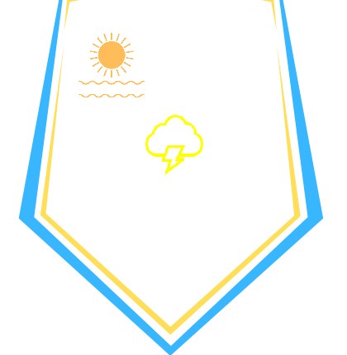
Congratulations! You’ve survived your second Disaster Challenge!
Return to the Disaster Challenge Map.

Slide 17
Oh no! You picked the wrong Havoc Pack!
During a heat wave, do not use an electric fan! Fans can increase your risk of contracting a heat-related illness, because while the air flow created by fans may give you the impression that you’re cooling down, they do not reduce your body temperature.
Do not open windows, as that will allow hot air from outside to enter your home and increase the indoor temperature.
Try Again

Slide 18
Oh no! You picked the wrong Havoc Pack!
During a heat wave, if you’re outside, you should stay in shaded areas. However, it is not advisable to go outside during a heat wave unless absolutely necessary.
Simply covering your windows with foil will not help.
You would need to cover a large piece of cardboard with foil and place it over windows, in order to reflect heat away from your home.
Sports drinks – with salt and sugar – should only be drunk if you are experiencing a heat-related illness.
Exercise should be avoided, to prevent your body temperature from rising.
When it’s hot, taking room-temperature or warmer baths can increase your body temperature.
Try Again

Slide 19
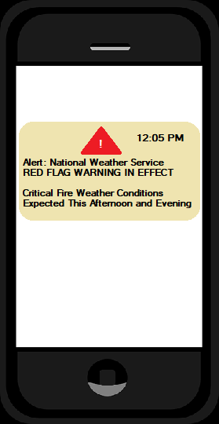
WILDFIRE
I’m Ready!

Slide 20
You have 45 seconds to choose the BEST Havoc Pack to survive a Wildfire!

Slide 21
You ran out of time . . . try again.
Try Again

Slide 22
Excellent! You picked the correct Havoc Pack!
When there is a wildfire in your area, the BEST things you can do are:
Make sure to sign up for emergency alerts.
Make an emergency kit with item you will need, such as clothing, prescriptions, and pet supplies (if you have pets).
Evacuate immediately, using the safest escape route available, and go to an area with low levels of smoke.
Have digital copies of important documents such as your birth certificate, passport, insurance cards, etc.
If you are trapped in place, call 911 and turn on house lights to help first responders find you.
Wear a N95 respirator to avoid breathing in smoke and ash.

Slide 23
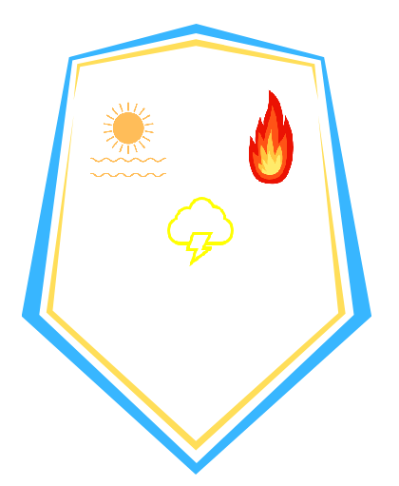
Congratulations! You’ve survived your third Disaster Challenge!
Return to the Disaster Challenge Map.

Slide 24
Try Again
Oh no! You picked the wrong Havoc Pack!
A bandana or handkerchief will not help you avoid breathing in smoke and ash.
Do not wait to evacuate!
Closed windows and doors will not keep fire out; they will not prevent all smoke and ash from entering your home.

Slide 25
Oh no! You picked the wrong Havoc Pack!
A cloth mask will not help you avoid breathing in smoke and ash.
In most cases, fire resistant safes cannot withstand the heat from a wildfire and important documents will burn.
Do not wait to evacuate!
Watering down nearby areas will not stop a wildfire.
Try Again

Slide 26
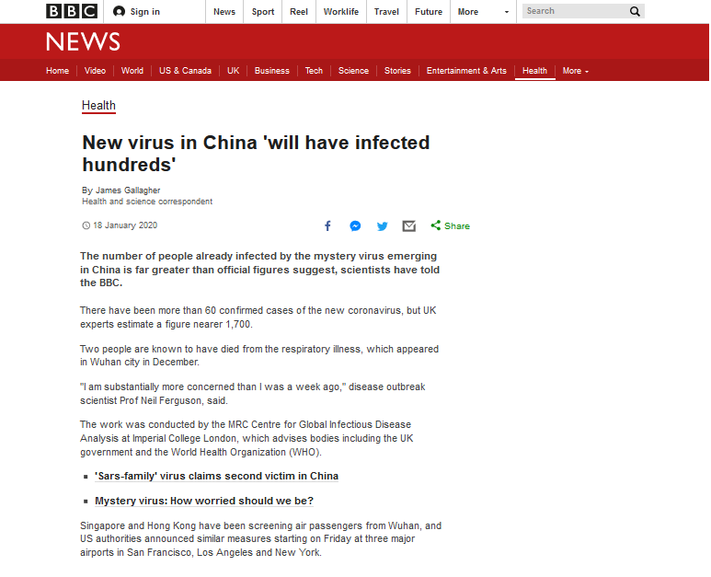
PANDEMIC
I’m Ready!

Slide 27
You have two minutes to choose the BEST Havoc Pack to survive a Pandemic!

Slide 28
You ran out of time . . . try again.
Try Again

Slide 29
Good job! You picked the correct Havoc Pack!
When there is a pandemic, it is important to be prepared and stay calm. To help keep yourself and others safe:
Have several weeks’ worth of non-perishable and freezable foods.
Purchase several weeks’ worth of toilet paper and tissues – but do not hoard or over buy these items, to ensure there is enough for everyone!
Maintain a social distance of at least 6 feet in all directions.
Stay at home unless you need to work (essential jobs), purchase multiple grocery items, or to get prescription medicine.
Wash/sanitize hands frequently – especially after using the bathroom, sneezing/coughing, and/or touching items/materials that are delivered or purchased from a store/individual.
Stay home if you feel sick to reduce the risk of spreading disease to others.
Always cover your mouth with a tissue or your elbow if you sneeze or cough.
To stay mentally and physically well, drink plenty of water, get at least 8 hours of sleep each night, exercise, and eat healthy food.
Check in on neighbors, friends, and family to help them maintain a sense of connection.
Clean frequently touched surfaces – bathrooms, countertops, light switches, door handles – as often as possible, ideally once per day.
Access reliable sources of news such NPR, and/or check the validity of sources using a fact-checking site such as Snopes.

Slide 30
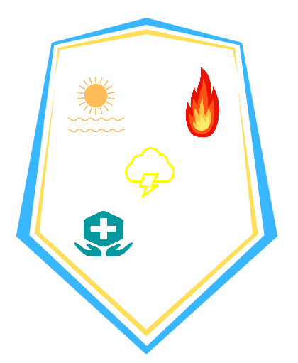
Congratulations! You’ve survived your fourth Disaster Challenge!
Return to the Disaster Challenge Map.

Slide 31
Oh no! You picked the wrong Havoc Pack!
8-10 weeks’ worth of food, water, toilet paper, and facial tissues is likely an excessive amount and could cause a shortage of necessary items.
It is best to avoid groups of any size to reduce your risk of being exposed, or exposing others, to illness.
Do not take ibuprofen, as it has been linked to increasing complications of respiratory illnesses.
Do not leave home more than is absolutely necessary.
N95 respirators are not necessary for most people and should be reserved for medical personnel.
Avoid eating unhealthy comfort foods to keep your immune system strong.
Clean hands frequently!
Do not get your news from social media sites, as they tend to contain a lot of potentially harmful misinformation from unreliable sources.
Try Again

Slide 32
Oh no! You picked the wrong Havoc Pack!
14-16 weeks’ worth of food, water, toilet paper, and facial tissues is likely an excessive amount and could cause a shortage of necessary items.
3 feet is an inadequate amount of social distance.
Do not take ibuprofen, as it has been linked to increasing complications of respiratory illnesses.
Do not leave home more than is absolutely necessary.
Medical masks are not necessary for most people and should be reserved for medical personnel.
Only go to the hospital if you experience trouble breathing or have an excessively high fever of 103 degrees or more.
10 hours of sleep is more than most people need to stay healthy.
Avoid easy-to-make food that is unhealthy.
Do not cover a sneeze or cough with your hands, particularly because you can easily spread disease by touching objects in your home or grocery store items.
If socializing with nearby neighbors, friends, or family, maintain adequate social distance at all times.
Clean hands frequently!
Try Again

Slide 33
TORNADO
I’m Ready!

Slide 34
You have 30 seconds to choose the BEST Havoc Pack to survive a Tornado!

Slide 35
You ran out of time . . . try again.
Try Again

Slide 36
Good job! You picked the correct Havoc Pack!
If a tornado strikes, the best things to do are:
Go to a basement or cellar. If you do not have a basement or cellar, go to a windowless room.
Place furniture and blankets around you, and cover your head and neck with your arms.
Listen to local alert systems/media for information and further instructions.

Slide 37
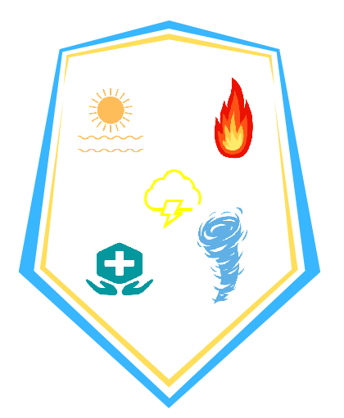
Congratulations! You’ve survived EVERY Disaster Challenge!
You are a MASTER of HAVOC!
END
See References

Slide 38
Oh no! You picked the wrong Havoc Pack!
During a tornado, stay away from all windows! If possible, seek shelter in a windowless room.
Try Again

Slide 39
Oh no! You picked the wrong Havoc Pack!
If you happen to be in a vehicle when a tornado strikes, do not try to outrun it! Do however, cover your face and neck with your arms and use a coat or blanket to cover your body.
Try Again

Slide 40
REFERENCES
World map (2020). Retrieved from www.Arkema.com
Ready.gov (2020). Thunderstorms & lightning. Retrieved from https://www.ready.gov/thunderstorms-lightning
BlueDelta (2018). Heavy thunder strike – no rain – QUADRO.wav [Sound file]. Retrieved from https://freesound.org/people/BlueDelta/sounds/446753/
Startgrid (2012). 1 minute timer [Video file]. Retrieved from https://www.youtube.com/watch?v=x6ggW8ei0yU
BoulderDamStudios (2013). EAS Tones » Local Area Emergency [Audio file]. https://freesound.org/people/BoulderDamStudios/sounds/181325/
Ready.gov (2020). Wildfires. Retrieved from https://www.ready.gov/wildfires
Adam Eschborn (2018). 45 second timer [Video file]. Retrieved from https://www.youtube.com/watch?v=NFAUVAPWxiE
CBS This Morning (July 19, 2019). Why overnight temperatures make U.S. heat wave even more excruciating [Video file]. Retrieved from https://www.youtube.com/watch?v=DQJPZ06rK_E
Ready.gov (2020). Extreme heat. Retrieved from https://www.ready.gov/heat
Gallagher, J. (2020). New virus in China 'will have infected hundreds.' Retrieved from https://www.bbc.com/news/health-51148303
Ready.gov (2020). Pandemic. Retrieved from https://www.ready.gov/pandemic
Ready.gov (2020). Tornadoes. Retrieved from https://www.ready.gov/tornadoes
IFartInUrGeneralDirection (2008). Siren.wav [Audio file]. Retrieved from https://freesound.org/people/IFartInUrGeneralDirection/sounds/46092/
Tornado video file made with Canva.com
Slide images made by Shanti Flaherty with Canva.com

